Slide 1
Lets talk about Sustainable tourism
Lecture 1

Slide 2
Complicated vs complexity?
Check in! how do you feel about those different terms and how are they different?

Slide 3
The CONCEPT OF SUSTAIN-ABILITY

Slide 4
3 Pillars of Sustainability
Planet – ecological
People – social
Profit – economic

Slide 5
Sustainable development
Our Common Future (Brundtland Report) 1987
‘…development that meets the needs of the present without compromising the ability of future generations to meet their own needs.’
A simpler rule of thumb – it’s all about relationships (to your land, to your community, to your suppliers, employees, family, etc)

Slide 6
Five basic principles
The idea of holistic planning and strategy making
The importance of preserving essential ecological processes
The need to protect both human heritage and biodiversity
The need to develop in a way that sustains productivity over the longterm for future generations
The need to achieve a better balance of fairness and opportunity between nations.

Slide 7
An inherently contested term
Sustainability often comes down to “needs” and values
So some questions are:
How do we balance different values?
How do we measure and articulate intangible values?
Can we interchange assets, replacing natural ones with engineered ones?
What is the role of growth within development?

Slide 8
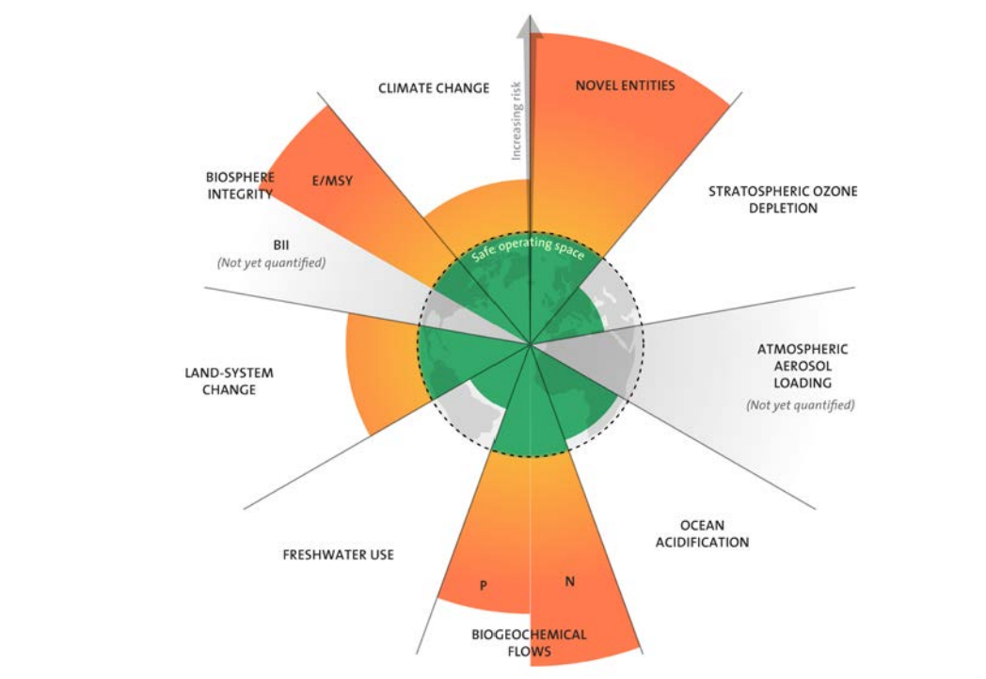
Planetary boundaries
Planetary boundaries diagram; orange sections indicate ‘overshoot’ of boundaries, green sections indicate a ‘safe’ state within the boundaries (data for 2022). Source: J. Lokrantz/Azote based on Steffen et al. 2015.

Slide 9
Sustainable tourism

Slide 10
Tourism: one possible definition …
“Tourism may be defined as the sum of the processes, activities, and outcomes arising from the relationships and the interactions among tourists, tourist suppliers, host governments, host communities, and surrounding environments that are involved in the attracting, transporting, hosting and management of tourists and other visitors”.

Slide 11
Sustainable Tourism
= tourism development that meets the needs of the present without compromising the ability of future generations to meet their own needs.
Focus on People, Planet and Profit

Slide 12
Sustainable Tourism should
Make optimal use of environmental resources that constitute a key element in tourism development, maintain essential ecological processes and help to conserve natural heritage and beauty
Respect the socio-cultural authenticity of host communities, conserve their built and living cultural heritage and traditional values and contribute to their inter-cultural understanding and tolerance.
Ensure viable, long-term economic operations, providing socio-economic benefits to all stakeholders that are fairly distributed, including stable employment, and income earning opportunities and social services to host communities and contributing to poverty alleviation.

Slide 13
At the most basic level
Sustainable tourism is about:
Being able to identify the immediate and extended effects of tourism
Minimising its negative social, environmental and economic impacts
Maximising its positive social, environmental and economic impacts
Selecting and recording the most appropriate indicators of sustainable tourism
Managing those impacts to within an acceptable range, as determined by stakeholders

Slide 14
A sequence of thinking about tourism
Advocacy platform
Cautionary platform
Adaptancy platform
Knowledge-based platform
Sustainability-oriented platform
Ethics based platform

Slide 15
Elements support sustainable tourism
International agreements
National policies
Peak bodies
Lobbyists
Certification schemes
Guide books, websites, etc.

Slide 16
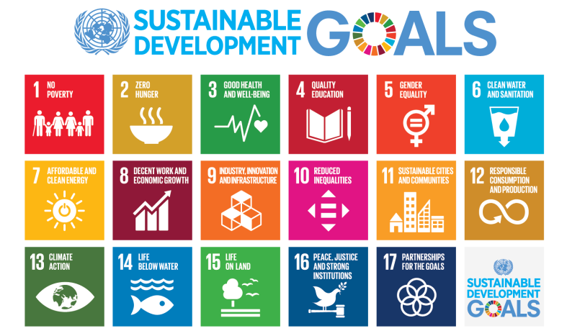
United Nations Development Program’s

Slide 17
UNWTO – One Planet
Promotes greater sustainability in tourism through “efficiency, innovation and adaptability”
The program has 4 main objectives:
Integrating sustainable consumption and production (SCP) patterns, in tourism-related policies and frameworks
Collaboration among stakeholders for the improvement of the tourism sector’s SCP performance
Fostering the application of guidelines, instruments and technical solutions to prevent and mitigate tourism impacts and to mainstream SCP patters among tourism stakeholders
Enhancing sustainable tourism investment and financing

Slide 18
UNWTO – One Planet (continued)
The program also focuses on 4 hot topics
Climate change
Ecotourism and protected areas
Small island developing states
Wetlands

Slide 19
Examples of destinations that embrace sustainable tourism
Bhutan – “happiness is a place”
Tofino – “be transformed, be here”

Slide 20
World Travel & Tourism Council
Membership-based organisation that aims to provide “empirical evidence to promote awareness of travel and tourism’s economic contribution, to expand markets in harmony with the environment, and to reduce barriers to growth”
WTTC also has a guide to sustainable reporting for tourism businesses to help business understand key concepts, provide an overview of trends and regulations, and identify implications and opportunities from being more sustainable
Their Tourism for Tomorrow awards recognise Best Practice in Sustainable Tourism globally.

Slide 21
Ecotourism as a form of sustainable tourism
Sometimes confused with sustainable tourism, ecotourism aims to:
Minimise damage to the environment, or better still, leave the environment in a better state than before
Provide economic benefits to the local community, both directly and indirectly through ecotourism’s supply chain
Encourage and develop greater awareness of the natural and socio-cultural environmental in which the ecotourism activities take place, through a deliberate and strategic interpretive program

Slide 22
Sustainable tourism as a complex issue
Sustainable tourism is best thought about in the context of a system
It is:
A complex whole
A set of interconnected components
A flow and exchange of energy, including people, money and goods.
Hierarchical in nature, small systems within larger systems

Slide 23
A new way of thinking – embrace complexity!
Making tourism sustainable involves
Balancing people, planet and profit
Understanding and tracking impacts within a complex system
Adaptive management that takes a holistic approach
Making values explicit
Drawing on policies, frameworks, peak bodies and other resources that can drive sustainability in tourism, e.g. Sustainable Development Goals.

Slide 24
Some facts and figures to illustrate challenges
the world’s top wealthiest 25% consumed three quarters of global resources, whilst the poorest 25% consumed 1.5% of resources
if we were all to consume at the same rates as America, we would require the natural resource equivalent of 4.1 Earths
tourism accounts for approximately 8% of emissions, with transportation for 75% of that footprint
Water and energy consumption are also disproportionately high in tourism

Slide 25
Next up…
Systems thinking for sustainable tourism

